Slide 1

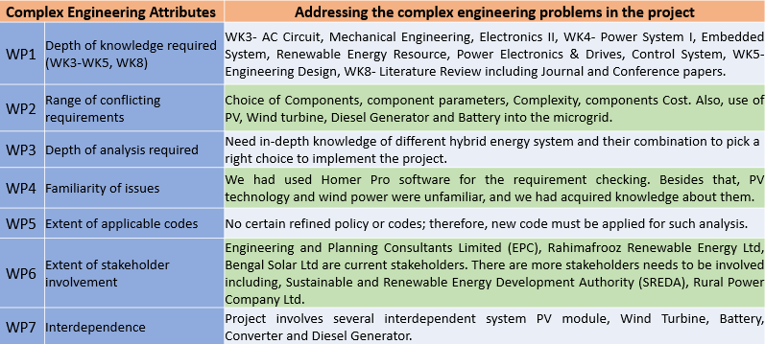
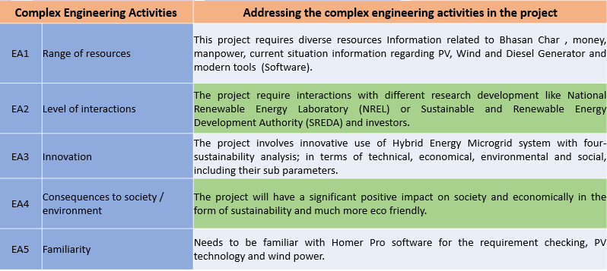
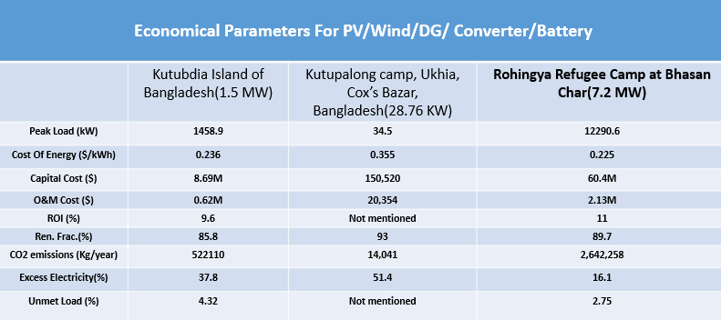
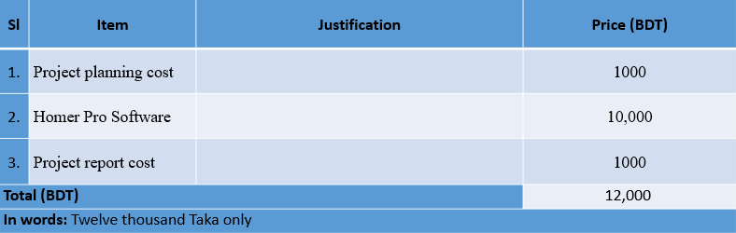
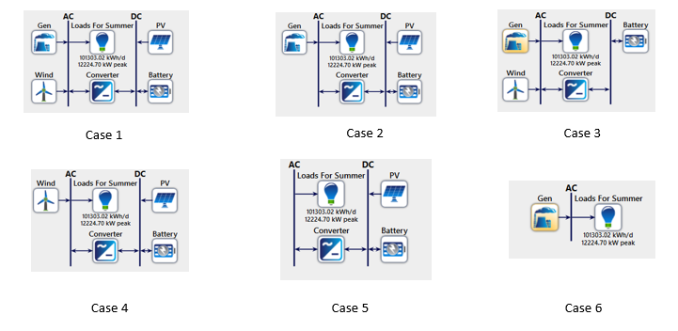
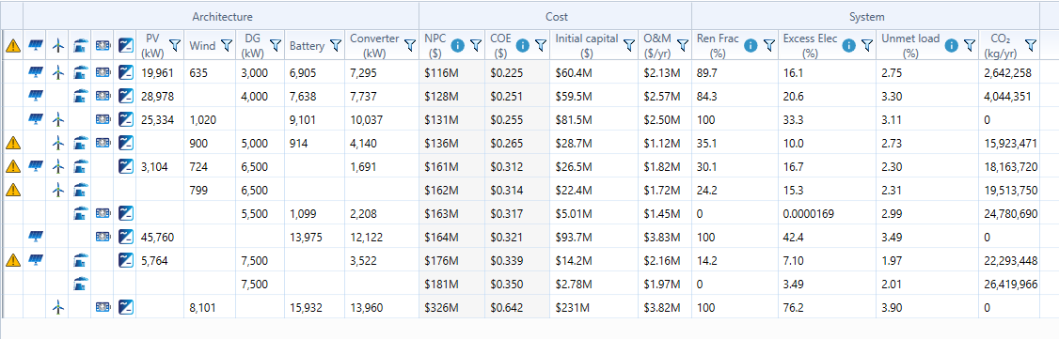
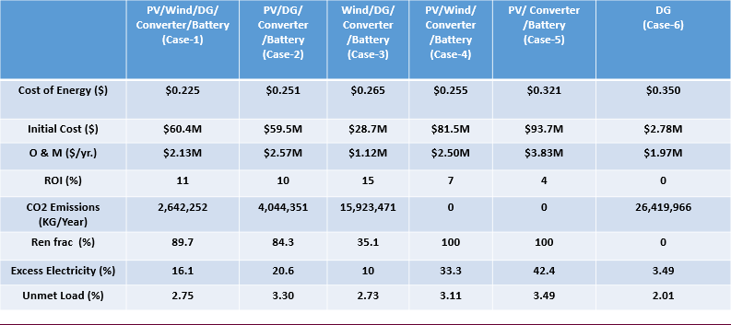
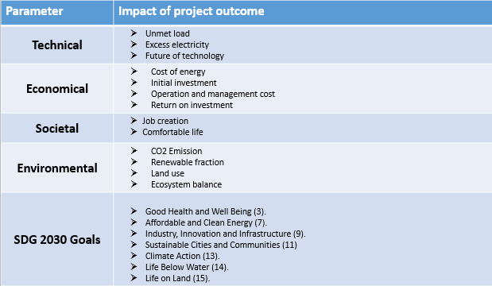
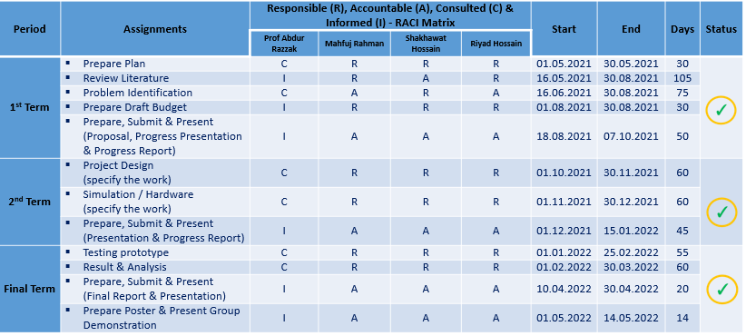
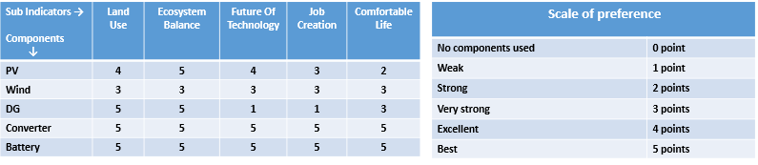
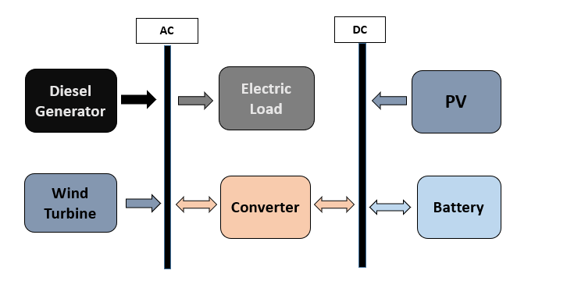
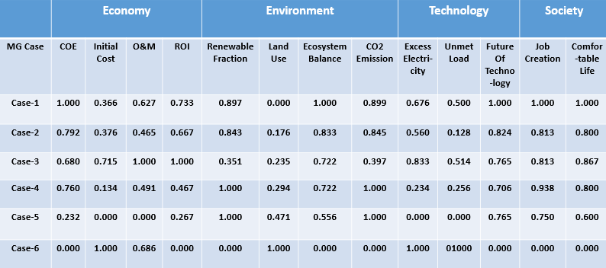
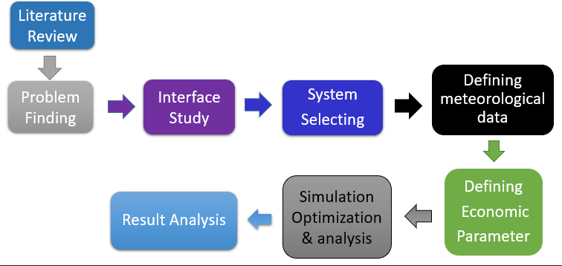
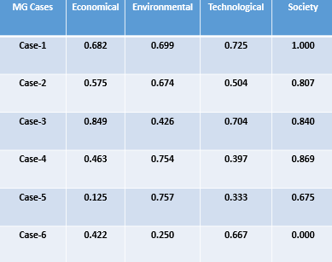
Sustainability Analysis of PV-Wind-Battery-Diesel Hybrid Microgrid for Rohingya Refugee Camp at Bhasan Char
Mahfuj Rahman, Shakhawat Hossain & Riyad Hossain
Department of Electrical and Electronic Engineering
Independent University, Bangladesh
FYDP
Spring 2022
Abstract
Complex Engineering Problems
Design Parameter
Microgrid Ranking
Bangladesh's recent economic expansion, driven by the country's rapid development, has increased demand for energy, increasing the country's dependency on fossil fuels such as natural gas and coal. The current thesis paper discusses the potential for the sustainability analysis study of hybrid microgrid for the efficient harnessing of the electricity in Bhasan Char, a small Island near Swandip located in Hatiya upazila, and the paper also recommends the use of PV/Wind/Battery/Diesel as an ideal hybrid microgrid system. To that goal, numerous combinations were created and thoroughly studied using simulations. A methodical approach was used to determine an optimal configuration by comparing the performance of several configurations by grouping together distinct parameters and different components. Including all the components in a configuration first, then attempting a different configuration one by one, such as a Diesel generator grouping with PV(Photovoltaic) and Wind Turbines, also PV(Photovoltaic) and Wind Turbines grouping independently, and many other configurations are used to obtain the most optimal and optimized outcomes. As previously indicated, simulations were used to identify the ideal arrangement.
Project Data
Parameters | Values
Project Life | 25 years
Nominal Discount Rate | 8%
Expected Inflation Rate | 3%
System Fixed Capital Cost | $0.00
System Fixed O&M Cost | 0.00 $/YR
Capacity Shortage Penalty | 0.00 $/YR
Maximum Annual Capacity Shortage | 5%
Wind Turbine Data
Parameters | Values
Rated Power | 10KW
Starting wind Speed | 3.5m/s
Cut-off wind speed | 24m/s
Hub height | 20m
Hour of peak windspeed | 14:00
Capital Cost | $2500$/KW
Replacement Cost | $1750$/KW
Operation & maintenance Cost | 100$/yr
Lifetime | 20years
Number of turbines considered | 0∼10,000
Complex Engineering Activities
Solar PV Data
Parameters | Values
Rated Power | 1KW
Capital Cost | 1500$/KW
Replacement Cost | 1200$/KW
Operation & maintenance Cost | 26$/yr
Lifetime | 25years
Size Considered | 50-10,000 kW, 50kW interval
Derating Factor | 90%
MPPT | Not Used
DG Data
Parameters | Values
Capital Cost | 370$/KW
Replacement Cost | 300$/KW
Operation & maintenance Cost | 0.030$/Hour
Operational Lifetime | 15000 Hours
Minimum load ratio | 25%
Fuel curve intercept | 0.264L/hr/KW _{(rated)}
Fuel curve slope | 0.286L/Hr/kW_{(output)}
Capacity | 500KW
Ranking of Microgrids
MG Cases | Economic Priority | Environmental Priority | Technical Priority | Social Priority
Case-1 | 1 | 1 | 1 | 1
Case-2 | 3 | 3 | 4 | 3
Case-3 | 2 | 2 | 2 | 2
Case-4 | 4 | 4 | 3 | 4
Case-5 | 5 | 5 | 5 | 5
Case-6 | 6 | 6 | 6 | 6
Converter Data
Parameters | Values
Capital Cost | 800$/KW
Replacement Cost | 750$/KW
Operation & maintenance Cost | 10$/yr
Lifetime | 15Years
Efficiency | 95%
Sizes consideration | 0-10,000 kW 50kW interval
Battery Data
Parameters | Values
Nominal voltage | 48V
String | 1
Nominal capacity | 167Ah/1 kWh
Capital Cost | 110$/KWh
Replacement Cost | 100$/KWh
Operation & maintenance Cost | 180 $/year
Lifetime | 10years
initial state of charge | 90%
Final state of charge | 20%
Result Comparison with Similar Microgrids
Proposed Total Budget
Microgrid Configuration
Current Power Situation at Bhasan Char
Result Analysis
1 MWp PVDG hybrid plant.
120 of 5 kWp rooftop Off grid.
1440 of 200Wp rooftop Off grid implemented by Bengal solar.
1000 solar streetlight of 10W each implemented by Rahimafrooz.
Objectives
Homer Optimization - Simulation Results
Design a model for PV-Wind-Battery-Diesel Hybrid Microgrid Energy System.
Finding an efficient and suitable hybrid Microgrid system for Bhasan Char in terms of sustainability - technically, economically, environmentally and socially.
Total Connected Loads
SI | Load category | Appliances | Size (W) | Quantity | Total number | Total Connected Load (kW) in Summer | Total Connected Load (kW) in Winter
1 | Residential building load | Light | 40 | 36 | 1440 | 2073.6 | 2073.6
 |  | Fan | 70 | 16 |  | 1612.8 | 0
 |  | Motor pump | 1000 | 1 |  | 1440 | 1440
2 | Residential Hotel | Light | 40 | 50 | 1 | 2 | 2
 |  | Fan | 70 | 20 |  | 1.4 | 0
 |  | TV | 20 | 10 |  | 0.2 | 0.2
 |  | Air Conditioner | 1500 | 10 |  | 15 | 0
 |  | Motor pump | 2000 | 2 |  | 4 | 4
3 | Shopping mall | Light | 40 | 100 | 5 | 20 | 20
 |  | Fan | 70 | 50 |  | 17.5 | 0
 |  | TV | 20 | 10 |  | 1 | 1
 |  | Motor pump | 1000 | 2 |  | 10 | 10
4 | Medical and Hospital | Light | 40 | 100 | 5 | 20 | 20
 |  | Fan | 70 | 20 |  | 7 | 0
 |  | Fridge | 1000 | 1 |  | 5 | 0
 |  | Motor pump | 2000 | 2 |  | 20 | 20
5 | Educational Institute | Light | 40 | 40 | 5 | 8 | 8
 |  | Fan | 70 | 20 |  | 7 | 0
 |  | Motor pump | 1000 | 2 |  | 10 | 10
6 | Cyclone center | Light | 40 | 200 | 120 | 960 | 960
 |  | Fan | 70 | 50 |  | 420 | 0
 |  | Motor pump | 2000 | 2 |  | 480 | 480
7 | Streetlights |  | 10 | 1000 |  | 10 | 10
8 | Mobile Towers |  | 3000 | 2 | 1 | 6 | 6
9 | Ice making factory |  | 10000 | 2 | 1 | 20 | 20
10 | EV charging station |  | 5000 | 2 | 1 | 10 | 10
11 | Sanctuary |  | 1500 | 6 | 1 | 9 | 6
Total Connected Loads |  |  |  |  |  | 7189.5 | 5100.8
Project Plan – Gantt Chart
Task Name | 1st Term |  |  |  |  |  |  |  | 2nd Term |  |  |  |  |  |  |  | 3rd Term
 | May-21 |  | Jun-21 |  | Jul-21 |  | Aug-21 |  | Sep-21 |  | Oct-21 |  | Nov-21 |  | Dec-21 |  | Jan-22 |  | Feb-22 |  | Mar-22 |  | Apr-22
Project Selection
Research Literature
Problem Finding
Prepare Draft Budget
Prepare & Submit Project Proposal
Prepare & Submit 1st Term Progress Report
Prepare & Present 1st Term Progress
Study Interface & Simulation
Define Meteorological Data
Prepare & Submit 2nd Term Progress Report
Prepare & Present 2nd Term Progress
Economical Parameter
Optimization & Analysis
Final Report
Final Presentation
Project Demonstration
Homer Optimization Result for 6 Cases
Impact of project outcome on the environment and sustainability
Work Plan – RACI Matrix
Assigning Values to Sub-Indicators
Limitations
Information related to Bhasan Char is very limited.
Implementation this project will cost a huge sum of money and manpower and high level of cooperation from government.
No certain policy is currently presented for such sustainable analysis for hybrid systems.
Proposed Microgrid
Normalized Value of Sub-Indicators
Conclusions
6 microgrid configurations have been evaluated and analyzed, in terms of 4 key sustainable performance parameter, including 13 sub indicators.
An estimated load calculation is done for which optimization is done using HOMER Pro load dispatch technique and to determine size of each component.
We have concluded the hybrid system of PV/Wind/DG/Converter/Battery is more feasible and sustainable for Bhasan Char Rohingya Refugee Camp.
Research Methodology
Average Values of Each KSPI and Weighted Scores
Homer Pro Software Framework
Future Works
Input
Resource data
Load profile
Economic details
Microgrid constraints
Homer Pro Optimization
Optimal MG components
Output
Net present cost
Cost of energy
Capital cost
Total energy production
Excess energy generation
Capacity shortage
Unmet load
Many more analysis can be done on this project in the future, using HOMER pro software, adding different renewable resources like ‘Biomass or Wave energy’ and more sensitivity cases.
This analysis will help academies and policymakers to make a refined system or policy for an analyzing sustainability analysis of hybrid microgrids.

